Slide 1

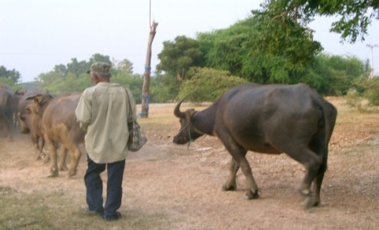
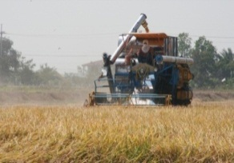
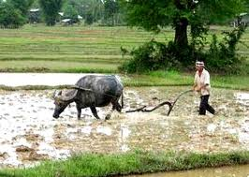
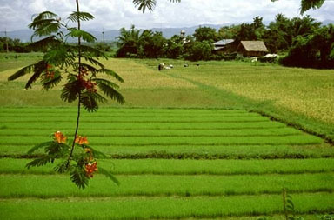
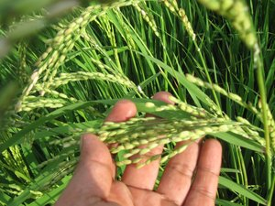
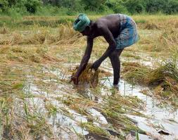
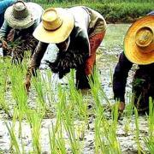
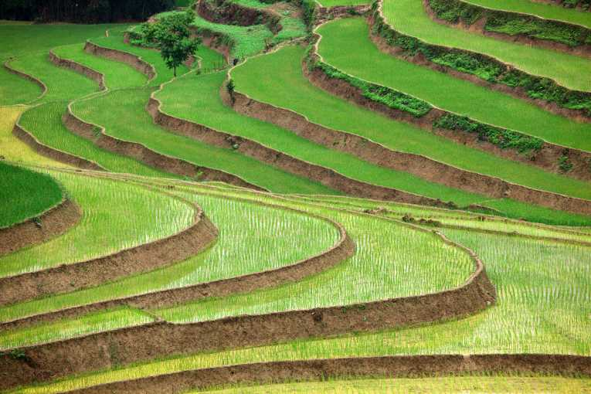
Thailand Rice Economy and Trade
สถาบันคลังสมองของชาติ
Special lecture for course 01007496
Selected Topic (Agricultural Entrepreneur Capacity Building)
November 5, 2013 at room no. 317 Faculty of Agriculture
Assc.Prof. Somporn Isvilanonda
Knowledge Network Institute of Thailand
E-mail address: somporn@knit.or.th

Slide 2
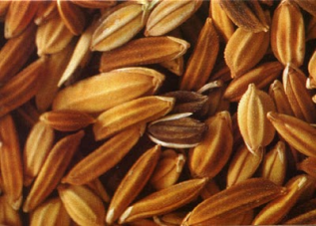
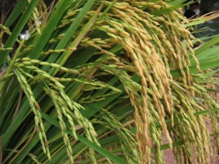
Outline -------------------
  Introduction
  Understanding the World Rice Market
  3. Dynamics of Thailand Rice Production Economy
  4. Rice Trading and Marketing
  5. Government Rice Policy and It impacts
  6. ASEAN Economic Community and Rice Trade
  7. What Factors Causing a Reduction of Thai Rice in Export Markets?
  8. Question and Discussion
สถาบันคลังสมองของชาติ

Slide 3
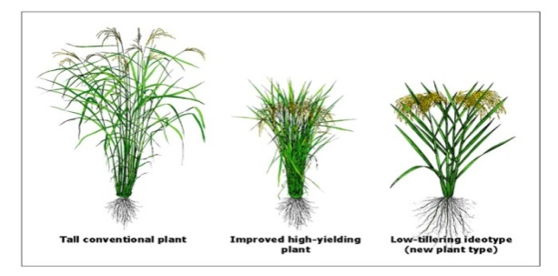
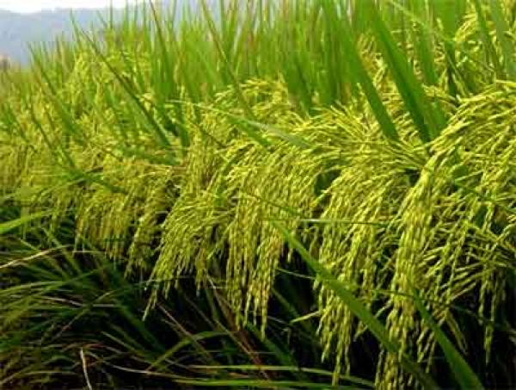
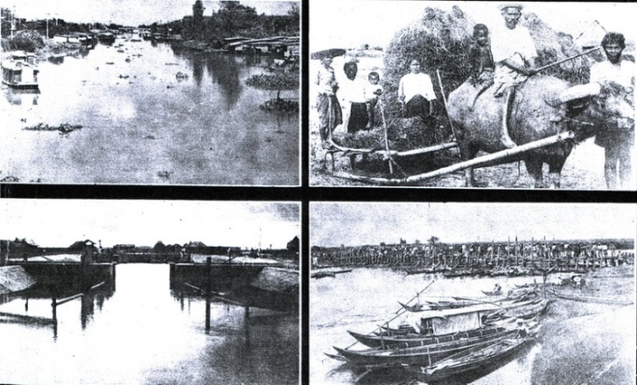
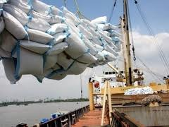
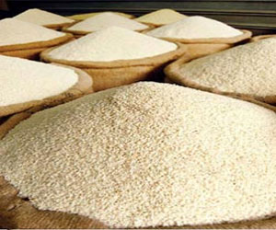
“Thailand Rice Economy and Trade” Special: A lecture for course 01007496 “Selected Topic” (Agricultural Entrepreneur Capacity Building) November 5, 2013 at room no. 317 Faculty of Agriculture
1.Introduction
3
สถาบันคลังสมองของชาติ

Slide 4
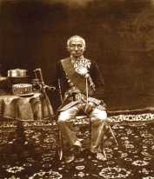
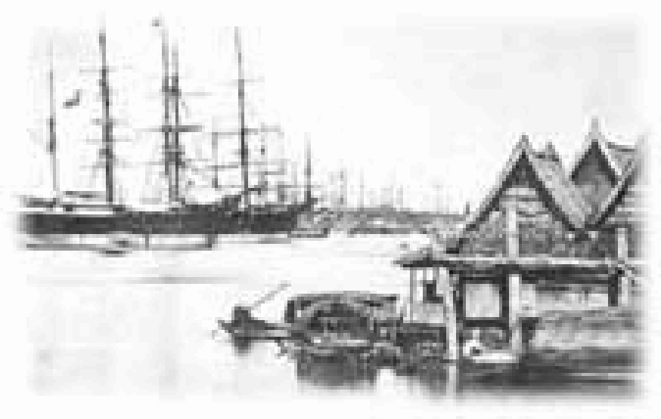

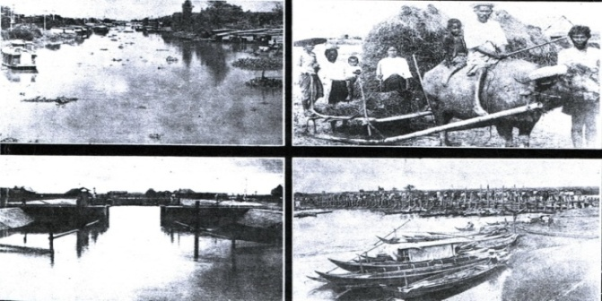
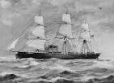
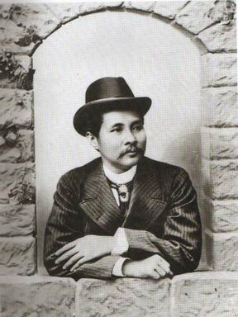
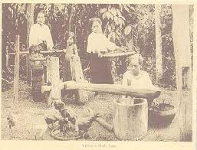
1.Introduction
1.1 Bowring Treaty Agreement and Rice Thailand Rice Trade
The Bowring Treaty is the name given to an agreement signed on April 18, 1855 between the United Kingdom and the Kingdom of Siam that liberalized foreign trade in Siam.
James C. Ingram (1955) wrote in a book “ Economic Change in Thailand Since 1850” and explained for the changes in Thailand rice economy that “…since the Bowring Treaty was signed in 1855(2398), Thailand rice trade with the west has rapidly jump. This induced the expansion of rice area from 5.8 million rai in 1850(2393) to 9.1 million rai in 1905 (2448) which was around nearly double in the following 4 decades” . The area was jump to 34.6 million rai in 1950(2493).
4
สุนทรี อาสะไวย์(2530)

Slide 5
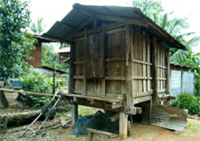
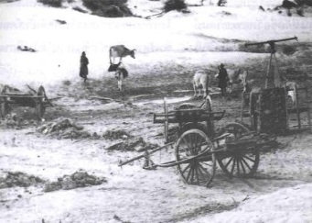
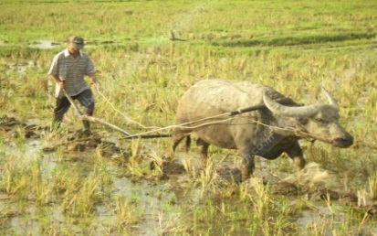
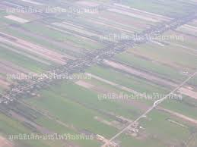
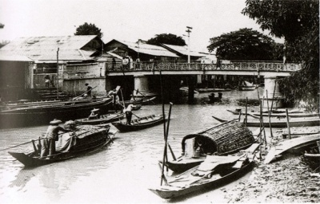
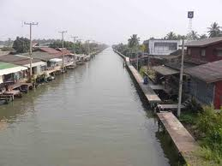

1.Introduction
1.1 (continued)
In those day, rice could grow only one crop a year and was not enough to meet with the high demand in the world market.
Rice was a strategic and important commodity in Asian continent since it was a common diet of people in the region. Deficit of rice from the production required imported to add up the domestic supply and prevented from food shortage.
Thailand was small country but abundant of land area due to very few man-land ratio. The production or rice had a very large surplus and was traded , particularly with China in in the ancient time.
● A brightness of rice trade in those day provided a large amount of tax return to the treasury. The King, particularly Rama 5, used that tax return to finance infrastructure development, particularly man-made canals in the central region for promoting rice area expansion and stimulating HH migration to remote areas.
5

Slide 6

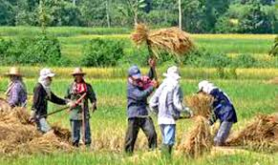
1.Introduction
1.1 (continued)
● In 1905(2448) Siam in those day earned the value of rice export around 80 million from the total export of 100 million baht. (Ingram 1955)
● During the second WW (1939-1945), rice shortage was wide spread and intensified through out Asia. After the war end, Thailand was forced to send rice to the United Nation as a war reparation.
● The Thai government set up the rice office which is a monopsony office to collect rice from domestic market for delivering the UN. The office was abolished in 1948 after the war reparation was met. But Thailand instead created “rice premium” for taxing the rice export.
● A large investment on rice research, including the establishment of IRRI (to remedy the world rice hungry) was later discovered non-photosensitive rice variety (MV) or IR8 in 1963. It has a short stem but high responds to chemical fertilizer, particularly in irrigated areas.
● A wide dissemination of MVs through out the rice growing region had accelerated expansion of rice supply and help relief the rice shortage. A rise in rice supply consequently induced the rice price decline, causing Thailand to abolished the rice premium in 1986.
6

Slide 7
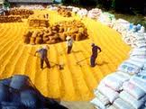
“Thailand Rice Economy and Trade” Special: A lecture for course 01007496 “Selected Topic” (Agricultural Entrepreneur Capacity Building) November 5, 2013 at room no. 317 Faculty of Agriculture
2. Understanding the World Rice Market
7
สถาบันคลังสมองของชาติ

Slide 8
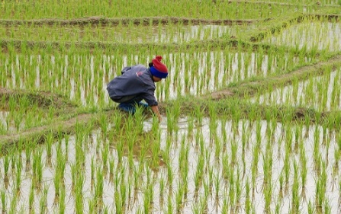
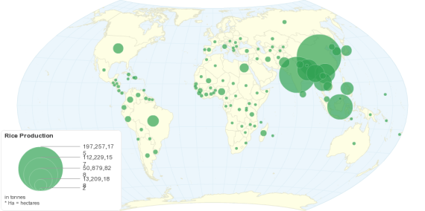
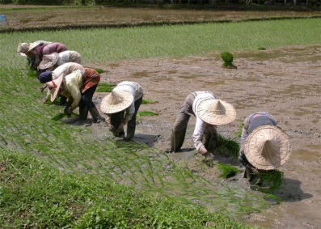
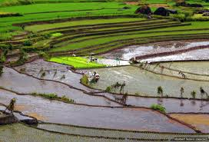
2. Understanding the World Rice Market
2.1 World Rice Production and Supply
➢ World rice production and Major producers
✓Major rice production countrues
Country | Production 2012/13 (million ton) | %
China | 143 | 30.5
India | 101 | 21.6
Indonesia | 36.9 | 7.9
Bangladesh | 34 | 7.3
Vietnam | 27.7 | 5.9
Thailand | 20.5 | 4.4
Others | 105 | 22.4
Total | 468.1 | 100
● World production in term of milled rice 468.1 million ton in 2012/13
●Asia is the major region in rice production. The world top three production countries are China, India and Indonesia which share about 60% of global rice production.
Source: Grain: World Market and Trade, USDA, August 2013
สถาบันคลังสมองของชาติ

Slide 9
2. Understanding the World Rice Market
2.2 Share of some major export countries
➢ Total rice trade in the world market rice was 39 million ton in 2012 . The top three exporters are India, Vietnam and Thailand
✓Major Rice export countries in 2012
Country | Amount (mil. ton) | %
India | 10.25 | 26.19
Vietnam | 7.72 | 19.73
Thailand | 6.95 | 17.76
Pakistan | 3.40 | 8.69
USA | 3.31 | 8.46
Brazil | 1.11 | 2.84
Uruguay | 1.06 | 2.71
Cambodia | 0.80 | 2.04
Myanmar | 0.69 | 1.76
Argentina | 0.61 | 1.56
อื่นๆ | 3.23 | 8.26
รวม | 39.13 | 100.0
Source: Grain: World Market and Trade, USDA, August 2013
Source : World Grain Situation and Outlook, USDA August 2013

Slide 10
2. Understanding the World Rice Market
2.3 Global Rice Consumption
สำนักงานคณะกรรมการกำกับการซื้อขายสินค้าเกษตรล่วงหน้า
✓Major rice consumption countries
Country | 2013 (mil.ton)
China | 144
India | 95
Indonesia | 40
Bangladesh | 34.5
Vietnam | 20.1
Philippines | 13
Thailand | 10.6
Mynmar | 10.4
Japan | 8.3
Brazil | 8
Nigeria | 6
Korea | 4.8
USA | 4.0
Egype | 3.9
Others | 67.7
รวม | 470.3
●90 % of rice is consumed in Asia.
● Top- three rice consumption countries are China, India, Indonesia which shares about 60% of global rice consumption.
World Rice Consumption 2013
Source : World Grain Situation and Outlook, USDA August 2013

Slide 11
2. Understanding the World Rice Market
2.3 (continued)
Per Capita Rice Consumption in Selected Countries

Slide 12
2. Understanding the World Rice Market
2.4 Component of Demand and Supply in the International Market and Rice Price Movement
❶ Supply component
❷ Demand component
1. World rice production
1. World rice consumption and industrial use
2. World rice stock at the end of last year
2. World rice stock at current year
Changes in Supply and demand components would induce a change in international rice price.

Slide 13
2. Understanding the World Rice Market
2.5 Price Determination in World Rice Marekt is Complex
● World rice trade is very thin. The amount of rice trade in the world market is around 39 million ton or about 8-9% of global rice production and consumption. High world rice stock is also depressed world rice price.
Production, Consumption, Stock and Prices in 2005/06-2012/13
ที่มา : Grain : World Markets and Trade, USDA Feb. 2013 และ Rice Outlook, USDA Dec. 2012

Slide 14
2. Understanding the World Rice Market
2.6 Population, Consumption and Production by Global Regions in 2010
Global regions | Population (mil.head) 1/ | Rice Consumption (1,000 ton) 2/ |  | Rice production (1,000 ton) 2/
 |  | quantity | % | quantity | %
Asia | 3791.10 | 386,472 | 86.58 | 403,550 | 89.36
-East Asia | 1550.67 | 152,143 | 34.08 | 153,931 | 34.09
-West Asia | 1610.60 | 133,520 | 29.91 | 137,675 | 30.49
-South-east Asia | 594.60 | 100,809 | 22.59 | 111,944 | 24.79
Middle East | 276.90 | 7,643 | 1.71 | 2,061 | 0.46
America | 891.10 | 23,058 | 5.17 | 25,947 | 5.75
Europe | 520.20 | 2,700 | 0.60 | 1,867 | 0.41
Soviet union | 284.80 | 1,395 | 0.31 | 1,223 | 0.27
Africa | 989.50 | 24,454 | 5.48 | 15,625 | 3.46
Others | 84.60 | 670 | 0.15 | 1,304 | 0.29
Total | 6838.20 | 446,392 | 100 | 451,577 | 100
ที่มา : 1/ World Food Statistic and Graphic,Kyushu University, Faculty of Agriculture
2/ Grain : World Markets and Trade , May 2011 USDA

Slide 15
สถาบันคลังสมองของชาติ
2. Understanding the World Rice Market
2.7 Summary
● World population in 2012 was 6.8 billion. It was expected to reach 8.9 billion in 2050 which increases around 2.1 billion
● Consumption demand for rice in Asia will increase according to rise in population but at slowly pace. This is because a per capita rice consumption in most Asian countries tend to decline.
● In 2013 the global rice consumption be ahead of the global rice production around 2 million ton (excluding stock).
● Changes in world stock, including supply and demand affect The world rice price.

Slide 16
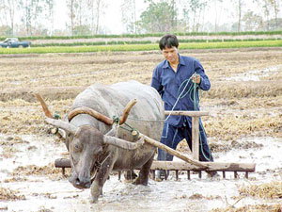
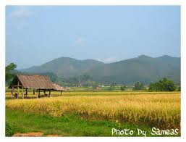

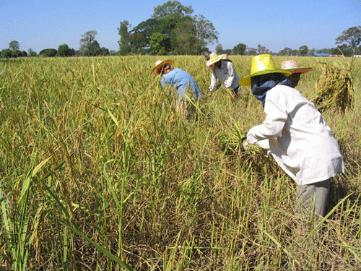
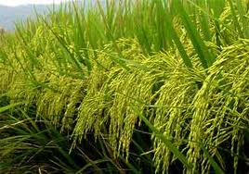
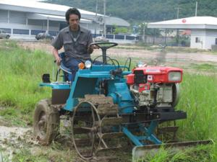
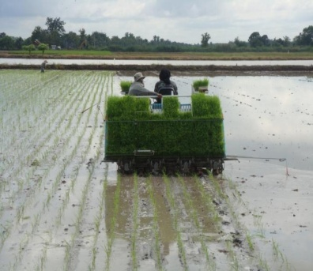
“Thailand Rice Economy and Trade” Special: A lecture for course 01007496 “Selected Topic” (Agricultural Entrepreneur Capacity Building) November 5, 2013 at room no. 317 Faculty of Agriculture
3. Dynamics of Thailand Rice Production Economy
16
สถาบันคลังสมองของชาติ

Slide 17
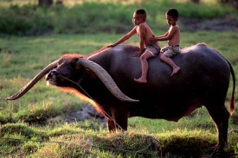

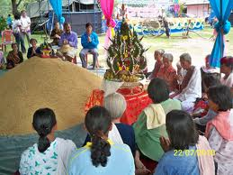


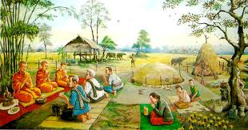
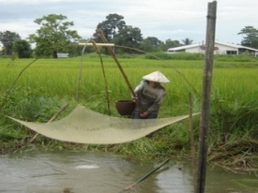
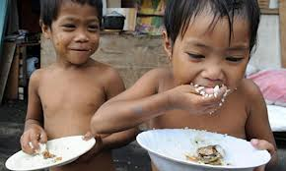
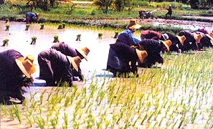
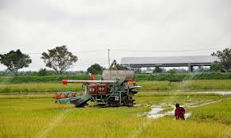
3. Dynamics of Thailand Rice Production Economy
3.1 Essence of Rice
➢Rice is for life
Rice is the essence of life. Thai people, since ancient times, believe that rice is important for their survival. It permeates all aspects of the life of people from all falks of life. Rice is a tradition, a wisdom of knowledge, a culture, a staple food , and others.
➢Rice means food in a daily diet
● Rice is a basic staple food crop. For households’ food security, rural people planted rice for their owned food supply and sold the surplus to the market.
➢Rice is an occupation
Rice is source of farm income. About 3.7 million hh. (or 78%) are rice cultivation hh.
Changes in rural economy induced commercial production which has consequently expansion in area and production and productivity improvement through new technology adoption.

Slide 18
3. Dynamics of Thailand Rice Production Economy
3.1 (continued)
➢Rice occupies a large number of country resources
➢ Rice is a source of export Income
Agricultural area in Thailand is 149 mil. rai. About 53% is used for rice production in 2012.
Thailand is one of the tenth in world food export.
✓Export value of rice and some selected agricultural products.
Labor force in rice farming was about 9.83 million people or about 27% of agr. labor force.
Items | 2011 (mil. baht) | 2012 (mil. baht)
1. Para rubber | 382,903.5 | 270,153.8
2. Rice | 193,842.5 | 142,976.2
3. Cassava and processing | 79,805.2 | 87,289.0
4. Chciken processing | 57,045.4 | 61,968.5
5. Shrimp and frozen shrimp | 52,101.9 | 45,184.1
6. Fruit( fresh and dry) | 28,809.0 | 36,697.5
7. Fish fillet and frozen | 12,398.6 | 12,875.3
8. Squid and frozen | 12,286.5 | 12,842.3
9. Other fish | 7,151.3 | 7,501.5
10. Vegetable(fresh dry and frozen) | 7,308.8 | 7,242.7
✓Share of planted area
Share of Planted area | 2001-07
Rice | 59.53
Upland crop | 20.84
Vegetable | 0.32
Tree crop | 19.31
Total | 100.00
Farm area/hh (rai) | 22
Source: calculated from OAE data
Source : Office of Permanent Secretary, Ministry of Commerce

Slide 19
3. Dynamics of Thailand Rice Production Economy
3.2 Country’s Rice Area and Production
● Rice is grown in all regions in Thailand. Rice area is around 79 million rai. Wet season rice share about 80% of the total rice planted area. Only one–fifth is dry season rice area.
Planted area by regions
Year | Planted area by Rgion |  |  |  |  |  | Total
 | NE |  | N |  | C | S
Planted area (mil.rai)
2546-50 |  | 33.54 | 15.89 |  | 15.2 | 2.29 | 66.92
2551-55 |  | 39.39 | 19.74 |  | 16.07 | 1.79 | 76.99
Ratio of planted area (%)
2551-55 |  | 51.17 |  | 25.64 | 20.87 | 2.32 | 100
● N.E. is the largest share of planted rice area, following by N. and CP.
● A commercial rice areas are in CP. and LON. A larger share of irrigated areas in these region has resulted in a better yield and a larger share of production
Source: Calculated from OAE data set
Production by regions
Year | Production by Region |  |  |  |  |  | Total
 | NE |  | N |  | C | S
Production (ton/rai)
2546-50 |  | 9.61 | 8.85 |  | 9.25 | 0.90 | 28.65
2551-55 |  | 13.34 | 10.97 |  | 9.88 | 0.75 | 34.94
Ratio of Production (%)
2551-55 |  | 38.18 |  | 31.40 | 28.28 | 2.14 | 100
● Rice Production in Thailand is about 35 million ton. The wet season share is around 71%. The rest is dry season.
● Ensuring for good rice quality in production process a GAP has been introduced including organic production in some areas.
Source: Calculated from OAE data set

Slide 20
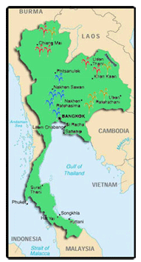
3. Dynamics of Thailand Rice Production Economy
3.2 (continued)
➢ Rice Growing Areas by Types of Rice
●Non-glutinous rice is grown in central area and lower north. But glutinous is grown in upper north and upper northeast. The glutinous rice production is around 4 million ton.
Jasmine or KDML 105 is grown in northeast. Its production is around
8 million ton.
Glutinous rice area
Upper N. and Upper NE
Jasmine rice area
NE and Upper N.
Non-glutinous rice area
Lower N. Center,
and south
Source : Modified from OAE data

Slide 21
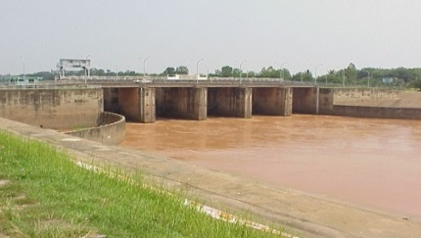
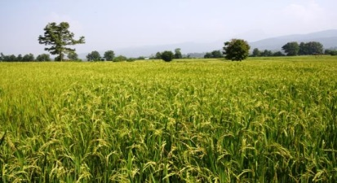
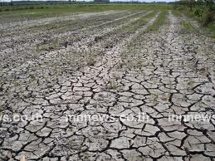


3. Dynamics of Thailand Rice Production Economy
3.2 (continued)
➢ Rice Planted Area in Irrigated and Rainfed Environments
●Irrigated rice area is around 23.93 million rai or 32.65 % of planted rice area. Most of rice area in Thailand is in rain-fed environment. The production is around 17 million ton.
● Rice production in irrigate area is about 8 million ton in wet season and about 9 million ton in the dry season.

Slide 22
3. Dynamics of Thailand Rice Production Economy
3. 3 Sources of Rice Production Growth
● Agr. basic infrastructure development plans since early 1960s stimulating changes in farming systems toward relatively more commercial production.
● Progress in irrigation improvements in combining with a dissemination of MVs induced modern technology adoptions .
Rice production increased nearly 4 times from 1967 to 2012 as a result of productivity and rice cropping intensity improvements.
Source: Office of Agricultural Economics, Ministry of Agriculture and Cooperatives .

Slide 23
3. Dynamics of Thailand Rice Production Economy
3.3 Green Revolution and Rice Cropping Intensity
➢Green revolution contribution
● Since 1969 (2512) , a wide spread of MVs adoption has induced rice cropping intensification from one crop a year to be at least two crops a year in irrigated area.
Period | Irrigated area(Million rai) | Rice planted area(mil. rai) |  | Ave. production(mil. Ton/year)
 |  | 1st crop | 2nd crop
1966-1970 | 10.77 (2nd Develop. plan) | 45.53 | 0.48 | 12.87
1986-1990 | 27.18 (6th Develop. plan) | 57.88 | 4.55 | 19.11
2002-2006 | 27.99 (9th Develop. plan) | 57.44 | 9.31 | 27.62
2007-2012 | 28.53 (10th develop. plan) | 61.96 | 15.04 | 34.95
Source: OAE

Slide 24







3. Dynamics of Thailand Rice Production Economy
3.4 Labor Force in Rice Production Sector
➢ Declining trend in agr. And rice labor force
● Rapid growth of the country non-agr. Sector has continuously driven labor out of agr. sector
Year B.E. | Total LF | Agr. Setor LF |  | Rice sector LF
 | (million) | (million) | (% of LF) | (million) | (% of LF)
2516-20 | 22.80 | 15.28 | 67.03 | 10.83 | 47.50
2546-50 | 36.29 | 15.29 | 42.15 | 9.83 | 27.09
● Rising in wage rate induced farmer to recently adoption of farm mechanization. Combined harvesters are recently wide spread in particularly commercial rice production areas.
Year B.E. | Large tractor | Power tiller
 | (unit) | (unit)
2521-25 | 42,267 | 262,277
2546-50 | 3836,790 | 4,663,299
Source: calculated from OAE data set

Slide 25
3. Dynamics of Thailand Rice Production Economy
3.5 Cost and Return in Rice Production
Revenue and cost of typical farm in Rain-fed Environment
Farm Production cost 144,942THB
(or 28,988THB/ha)
● 65.25% share of direct cost
● 34.74% share of fixed cost
Item | unit | 1st rice | Total | %
acreage | ha | 5
yield | t/ha | 2.86
Direct cost | THB |  | 94,592 | 65.26
-seed | THB/ha | 3,125 | 15,500 | 10.69
-fertilizer | THB.ha | 5,095 | 25,271 | 17.43
-plant protection | THB/ha | - | - | -
-Fuel | ThB/ha | 714 | 3,540 | 2.44
-Hired and family Labor 1/ |  |  | 47,402 | 32.70
-other |  |  | 2,880 | 1.99
Fixed cost | THB |  | 50,350 | 34.74
-Land | THB |  | 39,680 | 27.38
-Depreciation | THB |  | 8,388 | 5.79
-Interest | THB |  | 2,281 | 1.57
Total cost | THB |  | 144,942 | 100.00
Total cost per ton | THB |  | 10,136
Price per ton
-paddy 20,000THB.
Farm Revenue and Profit
● Farm revenue 283,414 THB
Farm profit 138,972 THB or
✓27,694THB/ha
✓9,683 THB/ton
Gross revenue | THB | 283,414
Total cost | THB | 144,942
Farm’s profit | THB | 138,972
Farm’s profit per ha | THB | 27,694
Farm’s profit per ton | THB | 9,683
Note: 1US$=30THB
Note: 1/ Hired labor including contract machine service Source: From calculation

Slide 26
3. Dynamics of Thailand Rice Production Economy
3.5 (Continued)
Revenue and cost of typical farm in irrigated environment
Item | unit | 1st rice | 2nd rice | Farm annual total (THB) | %
acreage | ha | 2.7 | 2.7 | 5.4
yield | t/ha | 5.6 | 5.56 | 5.58
Direct cost | THB/ha |  |  | 199,183 | 71.34
-seed | THB/ha | 3,142 | 3,076 | 33,577 | 12.03
-fertilizer | THB/ha | 4,922 | 5,031 | 53,746 | 19.97
-plant protection | THB/ha | 3,252 | 3,335 | 35,570 | 12.74
-Fuel | THB |  |  | 6,400 | 2.29
-Hired and family Labor |  |  |  | 58,695 | 21.02
-other |  |  |  | 11,195 | 4.01
Fixed cost | THB |  |  | 80,004 | 28.66
-Land (inc. opp. Cost) | THB |  |  | 54,375 | 19.48
-Depreciation | THB |  |  | 22,065 | 7.90
-Interest | THB |  |  | 3,564 | 1.28
Total cost | THB |  |  | 279,187 | 100.00
Total cost per ton | THB |  |  | 9,266
Farm production cost 279,187THB
● 71.34% share of direct
● 28.66% share of fixed cost
cost per ton =9,266THB
cost per ha= 51,701 THB
Note: 1US$=30THB
Note: 1/ Hired labor including contract machine service Source: From calculation

Slide 27
3. Dynamics of Thailand Rice Production Economy
3.6 Rice Utilization
● For domestic use of rice is about 17 million ton of paddy which is about 12 million ton in term of milled rice). This is for consumption, seed use, processing industry and feed milled industry)
● For seed use is about 2 million ton of paddy.
● HH rice consumption is about 101 kg/person/annual .This amount reduced from 115 kg/person/annual in BE 2535 (1992)
In 2555(2012) population in Thailand was around 68 million. It is estimated for consumption about 7 million ton of milled rice.
Half of rice production was export. Thailand was ranked first in the export rice market for nearly 2 decades. However, it was fall to the third in last year.
27

Slide 28




“Thailand Rice Economy and Trade” Special: A lecture for course 01007496 “Selected Topic” (Agricultural Entrepreneur Capacity Building) November 5, 2013 at room no. 317 Faculty of Agriculture
4 Rice Marketing and Trading

Slide 29
4. Rice Marketing and trading
4.1 Rice Standard and Components from Milling
➢ Rice standard and grading
● Standard moisture content of paddy sold in the market is 15%. Otherwise, the price will be deducted if the moisture content is above that level.
● Milled rice standards are classified according to grain size (short grain vs long grain; chemical content (high amylose vs low amylose); aromatic (aroma vs non-aroma); glutinous vs non glutinous); milling process (brown rice and white rice); colour (red rice purple rice, fancy rice)
● Milled rice for trading, general standards are white rice 100%, white rice 5%, white rice 25%, broken rice A1, broken rice A2 etc.
Components from milling paddy 1 ton
➲ White rice 5% 460 kg
broken rice A1 145 kg broken rice C1 40 kg broken rice C3 15 kg rice bran 105 kg
And also rice husk
➢ Paddy conversion ratio to milled rice
A ton of paddy is equivalent to 650 kg of milled rice.

Slide 30
4. Rice Marketing and trading
4.2 Paddy and Milled Rice Marketing
➢ The Rice Marketing
The Rice Marketing Channels Development
Farmers
Rice Mills
Brokers
Exporters
Farmer Institutions
Wholesalers
Central Market
Retailers
Local Assemblers
Paddy distribution
Milled Rice distribution
Local Rice Mill
Domestic
Consumers
Modified from Isvilanonda, 2004

Slide 31
4. Rice Marketing and trading
4.2 (contunued)
➢ The Packed Jasmine Rice Marketing
Packed Thai Jasmine Rice Distribution in Thailand
Farmers
Packed Rice
Entrepreneurs
Paddy distribution
Milled Rice distribution
Agri. Co-operatives
Assemblers
Central Market
Modern Trade
Retailers
Millers
Consumers
Millers’ House Brands
Wholesalers
Exporters
Source: Suchato et al., 2012

Slide 32

4. Rice Marketing and trading
4.3 Market Price Determination
➢ Paddy price determination
How much for paddy price?
Millers play plays essential role in converting the milled rice to paddy price.
They know well for their owned milling cost and including their owned capacity of rice conversion from paddy to be milled rice.
● They can better access price information from export markets and wholesale market in Bangkok.
● Previously Central wholesale markets plays essential role for making symmetry information in the paddy market by act as the trust agents for bargaining power between farmers and millers. But after heavy intervention in the paddy market by government under the pledging scheme at high price. Those who operated the Central were out of business in the recent past.
Source: Modified from AFET data

Slide 33

4. Rice Marketing and trading
4.3 (Continued)
✓ Milled rice market in Bangkok
Wholesale rice market in BKK is influential by exporters, wholesalers, and brokers. They can better access world market price at different destination.
Exporters when they get order from abroad many of them use their brokers to contact the millers in their own networks to acquire the rice at the compettitive prices.
About 200 exporters were registered with the MOC for their export license.
How much should we offer prices?
● For exporters, a quoted price is linked with the FOB price from international market plus their inside information which they accumulated in the past.

Slide 34
4. Rice Marketing and trading
4.4 Market Price Movement
➢ Price movements of exported price, BKK whole sale price and paddy price
ที่มา : สภาหอการค้าแห่งประเทศไทย, กรมการค้าภายใน, สำนักงานเศรษฐกิจการเกษตร, และธนาคารแห่งประเทศไทย

Slide 35
4. Rice Marketing and trading
4.4 Market Price Movement
➢FOB prices for different grades of rice and differents export countries
Source: FAO

Slide 36



“Thailand Rice Economy and Trade” Special: A lecture for course 01007496 “Selected Topic” (Agricultural Entrepreneur Capacity Building) November 5, 2013 at room no. 317 Faculty of Agriculture
5. Government Rice Price Policy and Its impacts
36
สถาบันคลังสมองของชาติ

Slide 37
5. Government Rice Price Policy and its impacts
5.1 Forms of Agricultural Policy
➢ Non-price policy
● Non-price policy mostly designed for improving production efficiency and for well being of farmers . It essentially drives the farmers’ production to be a competitiveness and sustainability.
➢ Market Policy
● Market policy is used for improving market structure and enhancing market efficiency for better benefit of both producers and consumers.
➢ Price Policy
Price policy is normally used as an instrument for reducing market price fluctuation and creating price stability. It is considered as a tool for making equity than efficiency purposes.
37
Notes:
37

Slide 38
5. Government Rice Price Policy and its impacts
5.2 Rice as an Economic Crop
Policy response for tacking farmers’ problems
Price and income policy
Non-market policy
มาก
Market policy
✓Improvement and development of irrigation systems for both regions and communities.
✓Investment in agricultural R&D.
✓Improving land productivity and tenure system.
✓Providing agricultural credit at a reasonable interest rate.
✓Market price and income intervention measures.
✓Improvement in logistics and storage facilities. ✓Enhancing and developing domestic and export market structure.
✓Future market improvement.
Notes:
38

Slide 39


5. Government Rice Price Policy and its impacts
5.3 Rice as a Political Crop
Types of policy response for tacking farmers’ problem
Price and income policy
Non-market policy
Market policy
✓Rice pledging scheme.
✓Deficiency payment measure.
Government official statement by prime minister Yingluck
✓ Using rice pledging scheme for securing farmers’ income. The pledging price is determined at 15,000 B/ton for normal paddy and at 20,000 B/ton for jasmine paddy with moisture standard at 14%.
ความเป็นธรรม
ที่มา:http://www.cabinet.thaigov.go.th

Slide 40
5.4 Evolution of Rice Pledging Scheme
5. Government Rice Price Policy and its impacts
Originated under the BAAC internal program for helping poor farmers who need cash during harvesting season. By allowing farmers to pledge rice for getting 80% cash from BAAC. But it was later enhanced to be the government program.
Crop year 2536/37 starting for invoice pledging.
Crop year 2543/44 Thai Ruk Thai Party increased the pledging target price to a slightly higher than the market price, including increasing size and budget of the program. This is equivalent to minimum price guarantee.
Crop year 2544/45 from previous limit to wet season crop. It was extended to include second season crop.
Year B.E. 2551, a pledging price was raised to 14,000 B/ton for dry season crop. It was later reduced to be 12, 000 B/ton in wet season crop year 2551/52.
Year B.E. 2553 The deficiency payment was used to replace a rice pledging scheme for quarantee farmers minimum income.
Starting from October B.E. 2554, the pledging price was reased to 15,000 B/ton for narmal paddy rice and 20,000 B/ton for jasmine pady rice.
40

Slide 41
5. Government Rice Price Policy and its impacts
5.5 Pledging scheme performance in crop year 2542/43
Operating in 67 provinces with a total of 325,000 individual farmers joined the program and about 400 cooperative institutes.
● The total amount of pledged paddy was 2.5 million ton with the credit under the program 14,725 million baht.
Type of paddy Target price (B/ton) Pledging price (B/ton)
✓Jasmine pledging price 6,840 6,495
✓Common paddy price 5,560 5,280
Notes:
41

Slide 42
5. 6 Comparing pledging price with market price from 2543-2552
5. Government Rice Price Policy and its impacts
B/ton
ที่มา | : The Department of Internal Trade , Ministry of Commerce, Thailand อ้างใน นิพนธ์ 2552

Slide 43
5. Government Rice Price Policy and its impacts
5.7 Amount and Value under Pledging Scheme and Their Redeemability
Crop year | Amount(ton) |  |  | Value(million baht)
 | Pledging | Redeemable | % of Redeemable | Pledging | Redeemable | % of Redeemable
2543/44 | 1,618,496 | 797,503 | 49.27 | 8,205 | 3,586.69 | 43.71
2544/45 | 4,298,144 | 1,128,985 | 26.27 | 23,493 | 6,170.92 | 26.27
2545/46 | 5,927,415 | 858,080 | 14.48 | 28,906 | 4,415 | 15.27
2546/47 | 2,668,336 | 696,508 | 26.10 | 12,429 | 3,282 | 26.41
2547/48 | 9,418,419 | 527,512 | 5.60 | 44,086 | 3,202 | 7.26
2548/49 | 9,479,869 | 1,193,801 | 12.59 | 71,773 | 10,902 | 15.19
2549/50 | 2,401,571 | 909,348 | 37.86 | 16,644 | 7,281 | 43.74
2550/51 | 4,297,127 | 160,396 | 3.73 | 53,143 | 1,593 | 3.00
หมายเหตุ: การรับจำนำนาปรังในแต่ละปีได้รวมต่อเนื่องไปกับฤดูนาปีในแต่ละปีก่อนหน้าฤดูนาปรังนั้นๆ
ที่มา: ข้อมูลปี 2543/44 และ 2544/45 จากอนันต์ ดาโลดม (2547) อ้างในศูนย์เศรษฐศาสตร์ประยุกต์ (2548)
สำหรับข้อมูลปี 2546/47 ถึง 2550/51 จาก ธนาคารเพื่อการเกษตรและสหกรณ์การเกษต
43
Notes:
43

Slide 44
5. Government Rice Price Policy and its impacts
5.8 The pledging Program induced Rice Mills Expansion
Number and milling capacity of large and medium rice mills have significantly expanded.
Region | Number of rice mills |  |  | Aggregate capacity (Ton/24 Hour)
 | Large | Medium | Total | Large | Medium | Total | % | Average
Year 2543
BKK | 17 | 5 | 22 | 3,416 | 82 | 3,498 | 97.66 | 200.94
Center | 382 | 331 | 713 | 26,352 | 4,595 | 30,947 | 85.15 | 68.98
North | 195 | 200 | 395 | 13,240 | 1,710 | 14,950 | 88.56 | 67.90
NE | 269 | 189 | 458 | 26,170 | 1,591 | 27,761 | 94.27 | 97.29
South | 8 | 98 | 106 | 267 | 901 | 1,168 | 22.86 | 33.38
Total | 871 | 823 | 1,694 | 69,445 | 8,879 | 78,324 | 88.66 | 79.73
Year 2551
BKK | 50 | 9 | 59 | 9,512 | 127 | 9,639 | 98.68 | 190.24
Center | 418 | 151 | 569 | 66,927 | 2,153 | 69,080 | 96.88 | 160.11
North | 308 | 114 | 422 | 49,179 | 1,265 | 50,444 | 97.49 | 159.67
NE | 355 | 57 | 412 | 53,633 | 551 | 54,184 | 98.98 | 151.08
South | 17 | 56 | 73 | 822 | 690 | 1,512 | 54.37 | 48.35
Total | 1,148 | 387 | 1,535 | 180,073 | 4,786 | 184,859 | 97.41 | 156.86
Source: Chaowakul (2009).
44
Notes:
44

Slide 45
5. Government Rice Price Policy and its impacts
5.8 (continued)
If the capacity is concerned, its too much investment in milling capacity.
Year B.E. | Average milling capacity of large rice mills (ton/day) |  |  |  | Total capacity (1,000 ton/annual) (1) | Total rice production(2) | Ratio of (1)/(2)
 | BKK | Center | North | NE
2543 | 200.94 | 68.98 | 67.90 | 97.29 | 28,588.260 | 25,844 | 1.11
2551 | 190.24 | 160.11 | 159.67 | 151.08 | 67,473.535 | 32,250 | 2.09
Source: Chaowakul (2009)
45
Notes:
45

Slide 46
5. Government Rice Price Policy and its impacts
5.9 Impacts of Pledging Scheme
Some farmers realized the rising in their income but that for very short run.
Government is a prime buyer in the market.
Private central market has to force out of business.
The paddy was not redeemed creating too much rice in the public rice stock as well as a budget burden.
High pledged price cause farmers to grow less quality rice.
High operation cost in managing the scheme.
● Agricultural future market trading on rice is vanished.
Poapongsakorn (2011) showed that it created a rent seeking of some involving group and including a corruption.
46
Notes:
46

Slide 47

5. Government Rice Price Policy and its impacts
5.10 Channels of Rent Seeking Opportunity
➢Activities Driving to Corruption Process
Source: Thaipublica

Slide 48
5.11 Increasing Budget burden
5. Government Rice Price Policy and its impacts
✓Total budget use in 2009 is about 120 billion baht.
✓During crop year 2011/12-2012/13, the government has already used the budget for the scheme about 680 billion baht (excluding operation cost)
Source: Spawasu (2009)

Slide 49
5.12 Deficiency payment policy
5. Government Rice Price Policy and its impacts
✓It was designed to guarantee minimum income to all rice growing households, particularly the poor farmers.
✓The program is also promoted a private sector in rice marketing.
✓Government does not engage in rice buying, processing, and selling.
✓ Lesser budget use in minimum income guarantee during crop years:
crop year 2552/53 =47,843 million baht
crop year 2553/54 = 67,580 million baht
49

Slide 50
5.13 Lesser Extent for Rent Seeking Activities
Operation process
การรับสินไหม
“ธกส.”
ลงทะเบียนประกัน
“ธกส.”
รับการตรวจฟาร์ม
“ธกส.เกษตร อบต.”
ขายข้าว
“ไม่ต้องขายให้รัฐ”
กำหนดราคาประกัน/ราคาอ้างอิง
“กรรมการ-ชาวนา”
Source: Nipon 2011
50

Slide 51



“Thailand Rice Economy and Trade” Special: A lecture for course 01007496 “Selected Topic” (Agricultural Entrepreneur Capacity Building) November 5, 2013 at room no. 317 Faculty of Agriculture
6. ASEAN Economic Community and Rice Trade
51
สถาบันคลังสมองของชาติ

Slide 52




6. ASEAN Economic Community and Rice Trade
6.1 Moving Toward Single Production and Marketing Base
ASEAN free trade was implemented since January 1, 2010. In 2013, it will integrating to be AEC.
● ASEAN profile in population and GDP
✓Total population 595 million
✓Size of GDP 1.5 trillion US$
ASEAN plus three
✓Population 2,112 million
✓GDP size 12.5 trillionUS$
52

Slide 53
6. ASEAN Economic Community and Rice Trade
6.2 Rice Trade Agreements in ASEAN
● Old ASEAN member agreed to implement 0% tax on rice trade since January 1, 2010 comprised of:
✓Thailand, Singapore, and Brunei
● Old ASEAN member still place high sensitive lst on rice trade but will to have a step of tax reduction comprised of:
✓Malaysia reduced from 40% to 20% in 2010;
✓Indonesia reduced from30% to 25% in 2015;
✓Philippine reduced from 40% to 35% in 2015
●New ASEAN member
✓Vietnam reduces from 20% to 0% in 2015
✓Laos PDR, Cambodia, Myanmar reduces from 5% to
0% in 2015

Slide 54






6. ASEAN Economic Community and Rice Trade
6.3 Moving toward Global Free Trade
✓Providing more opportunity to consumer than producer.
✓ Expanding a frontier of trade but on the other hand creating a non-tariff barrier among trading nations.
✓ Strong market competition and a driving force to quality competition.
✓ To comply with Sanitary measure and consumer safety, a new form of quality standard is implemented among the trading nations..
High competition in commodity trade inducing producers to acquire new technology for:
reducing production cost
improving product quality

Slide 55
6. ASEAN Economic Community and Rice Trade
6.4 ASEAN Rice Production and Consumption Profile
การผลิต การบริโภคและการค้าอาเซียนและอาเซียน + 3
Country | population (million) | 2012 profile (million ton)
 |  | Export | Import | Domestic production | Domestic consumption
Singapore | 5.2 | - | na | - | na
Malaysia | 29.0 | na | 1.09 | 1.73 | 2.82
Philippines | 95.0 | - | 1.50 | 10.70 | 12.85
Indonesia | 242.0 | - | 1.70 | 36.50 | 39.55
Brunei | 0.4 | - | na | na | -
Vietnam | 88.0 | 7.7 | - | 27.07 | 19.65
Thailand | 70.0 | 6.90 | - | 20.46 | 10.40
Laos | 6.3 | - | na | na | Na
Cambodia | 14.3 | 0.80 | - | 4.27 | 3.45
Myanmar | 48.3 | 0.70 | - | 10.82 | 10.19
ASEAN | 598.5 | 16.10 | 5.41 | 112.95 | 100.65
China | 1354 | 0.26 | 2.60 | 140.70 | 139.60
Japan | 127 | 0.20 | 0.65 | 7.65 | 8.05
S. Korea | 50 | - | 0.24 | 4.22 | 4.98
ASEAN + 3 | 2119 | 19.95 | 7.25 | 265.52 | 253.28
Source : Population from World Bank, Rice Production and Consumption data from Grain : World Market and Trade, USDA ; January 2013

Slide 56
6.5 ASEAN Rice Importer and Exporter 2012
6. ASEAN Economic Community and Rice Trade
ASEAN importer
Philippine 1.5 mil.ton; Indonesia 1.7 mil.ton; Malaysia and Singapore 1.5 mil. ton; other 0.7 mil. Ton; total import within ASEAN 5.4 mil. ton
ASEAN exporter
Vietnam 7.7 mil. Ton; Thailand 6.95 mil. Ton; Cambodia and Myanmar 1.5 mil. Ton; total export 16.1 mil. Ton.
Vietnam takes a leader in exporting rice in ASEAN markets. But Thailand still have advantage in African market.

Slide 57
6. ASEAN Economic Community and Rice Trade
6.6 Who is the winner in ASEAN Market?
57
สถาบันคลังสมองของชาติชาติ

Slide 58
6. ASEAN Economic Community and Rice Trade
6.6 (continued)
✓ Rice market shares of Thailand and Vietnam in 2011
Market by region | Thailand^{1/} |  | Vietnam^{2/}
 | Quantity (mil. ton) | % | Quantity (mil.ton) | %
ASEAN | 1,723,113 | 16.16 | 3,542,000 | 50.61
Non-ASEAN | 1,683,601 | 15.78 | 1,125,506 | 16.08
Middle East | 1,375,595 | 12.90 | 65,000 | 0.93
Europe | 488,650 | 4.58 | 133,019 | 1.90
America | 518,315 | 4.86 | 523,143 | 7.47
Africa | 4,687,962 | 43.95 | 1,580,084 | 22.58
Australia | 94,965 | 0.89 | 30,121 | 0.43
Oceania | 93,713 | 0.88 | - | -
รวม | 10,665,914 | 100.00 | 6,998,873 | 100.00
Source : 1/Calculated from Thailand Board of Trade data
2/ Vietnam Grain and Feed Annual 2012, USDA and Vietnam’s Rice
Industry in 2011, Agroinfo, Vietnam

Slide 59
6. ASEAN Economic Community and Rice Trade
6.7 What do this Data Imply?
Viet holds a large market share of 5% and 25% white rice in both Asia and outside Asia
Thai holds a large market share of premium rice and parboiled rice
✓Thai exports rice to Asia 2.43 mil.ton
✓Thai export rice to outside Asia4.46 mil.ton
✓Viet exports rice to Asia 5.75 mil.ton
✓Viet exports rice to non-Asia 1.97 mil.ton
Source: Thailand, calculated from Thailand Board of Trade data set; Vietnam, calculated from USDA: Vietnam Grain and Feed Annual 2013

Slide 60






  7. What Factors Causing a Reduction of Thai Rice in Export Markets?
สถาบันคลังสมองของชาติ

Slide 61







  7. What Factors Causing a Reduction of Thai Rice in Export Markets?
7.1 Higher production Cost
Production cost of Thai rice has continuously in increasing over the past few decades.
Thailand rice production cost double that of Vietnam in 2009
Item | Thailand rice production cost1/ | Vietnam rice production cost2/
 | B/rai | B/rai
Seed | 576 | 125
Fertilizer | 2,200 | 995
Pesticide | 376 | 171
Others | 122 | 113
Labor | 1,301 | 1,060
Variable cost(VC) | 4,576 | 2,465
Yield/rai | 814 | 800
VC/kg.(baht) | 5.62 | 3.08
Fixed cost (baht) | 1,240 | -
Total cost | 5,816 | -
Cost/Kg | 7.14 | -
Production cost in
1995 3.86 B/kg.
➲ 2009 7.14 B/kg.
Source 1/Isvilanonda (2552) 2/ Nguyen Tri Khiem (2010)
61

Slide 62
  7. What Factors Causing a Reduction of Thai Rice in Export Markets?
7.2 Implementation of Rice Pledging Policy at Higher than Market Price
Implementation of rice pledging scheme at 15,000 b/ton causing export price of Thai rice to high. At that paddy price, it raised the border price to US$ 800/ton while the word trade at a price of less than that level
Comparison of rice price in different export market by type of rice at February 2013
Type of rice | USA | Uruguay | Thailand | Vietnam | India | Pakistan
4-5% | 635 | 620 | 544
5% |  |  | 527 | 400 | 440 | 425
10% | 625 | 610 | 521 | 395
15% | 605 | 600 | 525 | 380
25% |  |  | 523 | 365 | 395 | 375
Parboiled |  |  | 550 |  | 420 | 450
Jamine |  |  | 1,166
Unit: US$ ต่อตัน Source: FAO rice price update November 2012 ใน http://www.thairiceexporters.or.th/

Slide 63
  7. What Factors Causing a Reduction of Thai Rice in Export Markets?
7.3 A Decline in Demand for Thai Rice and Loss of Market Share
● A high level of Thai rice price reduces its competitiveness and could not compete with competitors in export market. The export amount was significantly declined in all markets of Thai rice.
Region | 2554 (ton) | 2555 (ton) | % change
Asia | 3,407,551 | 1178589 | -65.41
-ASEAN | 1,723,162 | 621318 | -63.94
Middle East | 1,374,965 | 1300160 | -5.44
Europe | 488,650 | 287191 | -41.23
Africa | 4,687,962 | 3600471 | -23.20
America | 518,315 | 457052 | -11.82
Oceanic | 188,678 | 134548 | -28.69
Total | 10,666,120 | 6954516 | -34.80
Value(mil.Baht) | 192,956 | 147,082 | -23.77
Source: Thailand Board of Trade

Slide 64

7.3 (continued)
Thai rice export in 2011 and 2012 declining in almost types of rice.
ที่มา: วิเคราะห์จากข้อมูลสำนักงานเศรษฐกิจการเกาตร ด้วยความร่วมมือกับกรมศุลกากร

Slide 65








8. Question and Discussion
สถาบันคลังสมองของชาติ
ที่มาของภาพ: google.com

Slide 66

  7. What Factors Causing a Reduction of Thai Rice in Export Markets?
8.1 What does this graph show?
✓Presently, milled rice stock in Thailand could as high as 18 million ton.
Source: Oryza.com

Slide 67
Thank you
Notes:
67

